Slide 1


Poornima College of Engineering B. Tech. II Year (III Semester) NSP –I Phase Presentation Session: 2021-22
Project Title: Workout World Website
Submitted By: 3CSA8
Devendra Singh Rao, [PCE20CS051] RTU Roll No: 20EPCCS053
Divyansh Agarwal, [PCE20CS054] RTU Roll No: 20EPCCS056
Esha Kapoor , [PCE20CS058] RTU Roll No: 20EPCCS060
Gautam Sharma , [PCE20CS065] RTU Roll No: 20EPCCS068
Project Guide: Ms. Reena Sharma
Submitted To: Ms. Sonam Gour

Slide 2
Abstract
The purpose of Gym Website is to automate the existing manual system by the help of computerized equipment and full-fledged computer software, fulfilling their requirements, so that their valuable data/information can be stored for a longer period with easy accessing and manipulation of the same. The required software and hardware are easily available and easy to work with.
The main objective of the Project on Gym Website is to manage the details of Gym, Trainer, Member, Facility, Fitness Class. It manages all the information about Gym, Time Slot, Fitness Class, Gym. The project is totally built at administrative end and thus only the administrator is guaranteed the access. The purpose of the project is to build an application program to reduce the manual work for managing the Gym, Trainer, Time Slot, Member. It tracks all the details about the Member, Facility, Fitness Class.

Slide 3
Literature Review
Found that the public interest in exercise surged quickly following the first lockdowns, and other studies have shown behavioral changes toward increased physical activity and exercise. Earlier psychological studies already sought to investigate whether different types of exercise, typically aerobic or resistance training, are differentially related to mood outcome. This impression is put into perspective, however, as soon as one takes into account that the various studies have measured different aspects of physical activity and exercise.
A recent study amongst physiotherapy professionals and students inferred self-reported reduction in physical activity and energy expenditure, during the COVID-19 lockdown period. The study was executed by sending the online link of google forms to physiotherapy practitioners, teaching faculty and students via emails and social media platforms. The second sub-section included 7 questions on physical activity derived from validated IPAQ SF, followed by the third sub-section of 7 questions on self-reported anxiety levels using the validated GAD-7 questionnaire.

Slide 4
Drawing on surveys administered to both parents and teachers about how digital homeschooling was organized, we have investigated what kind of attendance school has required from students in different grades during the shutdown and the estimated PA they have engaged in during the period of homeschooling. Prior research has determined that PA plays an important role in both physical and psychosocial health and wellbeing for children and young people, and there is ample evidence that a sedentary lifestyle in students is associated with chronic diseases later in life and other health-related risk behaviors such as unhealthy dietary patterns.
The government takes preventive action by providing policies for the education sector, namely for students to replace face-to-face learning activities with online learning to prevent the gathering of many people in one room, this policy was taken by the government because of the obligation of students to continue studying. First, research conducted by, this study states that students in online learning have the same or even better learning outcomes than students who learn traditionally. The population in this study were all students of SMA PLUS ALFATIMAH who carried out online learning.

Slide 5
This review aimed to analyse if the PA levels of university students changed during the confinements and their adherence to the current global PA recommendations. Social distancing and confinements have largely altered the lifestyle of university students, and it is not clear how the changes in the aforementioned factors are affecting the PA levels of this population. To this purpose, one of the most important strategies is to reduce the mixing of susceptible and infectious people through early ascertainment of cases or reduction of contact, implementing measures such as quarantines and lockdowns, which have proven highly effective in controlling the spread of the disease.
Regular participation in physical activity or exercise has been shown to improve an individual’s total well-being and is regarded as a potent natural remedy for several popular mental illnesses, such as depression, anxiety, attention deficit hyperactivity disorder, stress, post-traumatic stress disorder, memory, thinking, self-esteem, increase energy, resilience, better sleep, mood, boost the immune system, and lower the influence of stress. Other types of exercises include strength exercises or resistance exercises such as weight lifting, push-ups, and crunches to improve lean muscle mass for bodyweight loss; balance exercise that could assist individual capacity to regulate and stabilize the location of the body; flexibility or stretching exercises that could improve individual range of motion and lower the risk of injuries

Slide 6
It is believed that the entry of SARS-CoV-2 in the human tissues is facilitated via angiotensin-converting enzyme, however, the poor absence of ACE-2 receptors in the central nervous system does not mean that CNS is resistant against this type of viruses.66 Indeed, it has been shown that when SARS-CoV-2 types of the virus were given intranasally to mice, the virus translocated into the thalamus and brainstem and was significantly lethal suggesting that CNS could be one of the targets of SARS CoV-2. The relatively long latency period of the virus of 5–12 days would allow the virus to significantly damage medullary neurons, and indeed, patients infected by SARS-CoV-2 reported severe neurologic symptoms manifested as acute cerebrovascular diseases, consciousness impairment and skeletal muscle symptoms
An important novel finding of the current study is that physical activity counteracted the negative impact of Coronavirus fear on mental health and well-being in adolescents. Moreover, the size of the beta weights in the regressions predicting depression, vitality, perceived health, and fatigue demonstrate that physical activity was a stronger predictor than Coronavirus fear. Indeed, physical activity is suggested to impact mental health in different ways, and some of these pathways might be especially relevant during the Coronavirus pandemic.

Slide 7
Industries most tied to health, fitness, and recreation have developed online exercise programming to help while emerging work determinants among the general population affected by the pandemic, empirical investigations on how these determinants affect populations that have been economically and socially marginalized are scant and unclear based on available evidence from the scientific literature. Changes at the social level involve creating community groups that help instill safety, motivation and continue to improve our understanding of physical activity behavior and its individuals and families move more at home
Daily exercise may help combat the disease by boosting our immune systems and counteracting some of the comorbidities like obesity, diabetes, hypertension, and serious heart conditions that make us more susceptible to severe COVID19 illness. Conversely, preclinical studies have also shown that intense exercise leads to poorer outcomes in response to respiratory viral infections. Animal experiments administering influenza and herpes simplex viruses An early epidemiological study suggested that intense, prolonged exercise was associated with an increase in upper respiratory tract infections.

Slide 8
Problem Statement & Objective
The purpose or objective of this technique is to digitalize and make an automatic system. The system will perform tasks like adding the new member to the gym, Removing the member or keeping the payments records and other stuff required in managing the gym properly. this scenario within the gyms is that the records are kept by writing during a file on paper. Every management task is completed manually.
This creates a system unreliable and confusing to keep the correct track of the records. The maintenance of a system like this is hardly required until it needs to change any part of the system. The information about the various things contained in the system are like members, trainers, the equipment can get by just a few clicks unlike the paper documents required the serious reading for such information.

Slide 9
Proposed Approach
Gym software will help the user to log in and signup in a user-friendly way and provides an easy to the user interface after that user can directly store information in the database. Gym management saves time by providing some procedures.
In the gym management system, after the design and analysis phase of the system gets completed. Then subsequent phase required to rework the collected required system information into a structural blueprint which can function a reference while constructing the working system. it's a phase when most of the risks and errors unveiled so it’s is sweet practice to require care of this thing from the beginning.

Slide 10
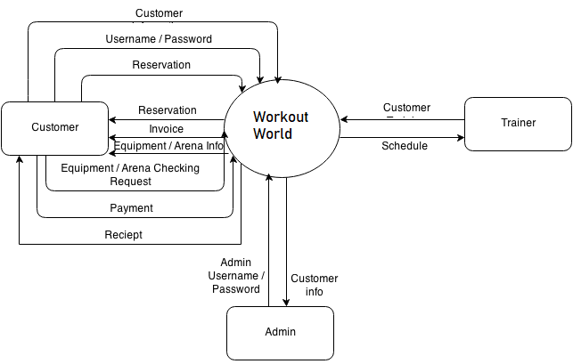
Design of Solution

Slide 11
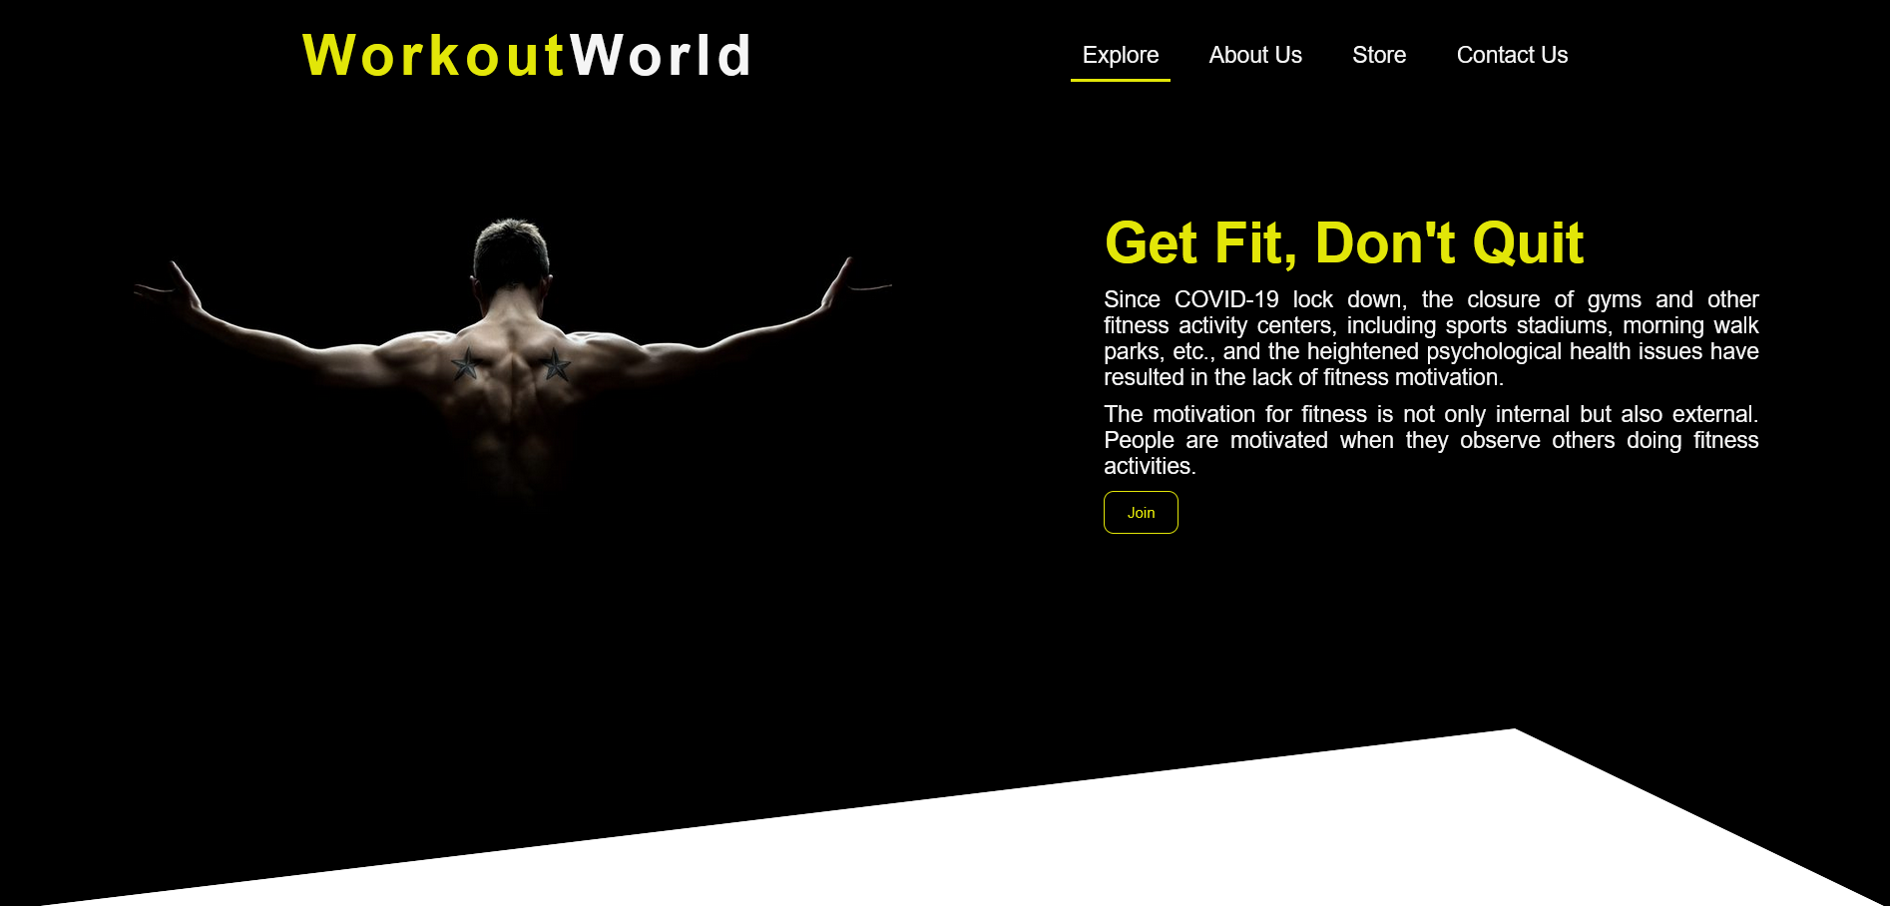
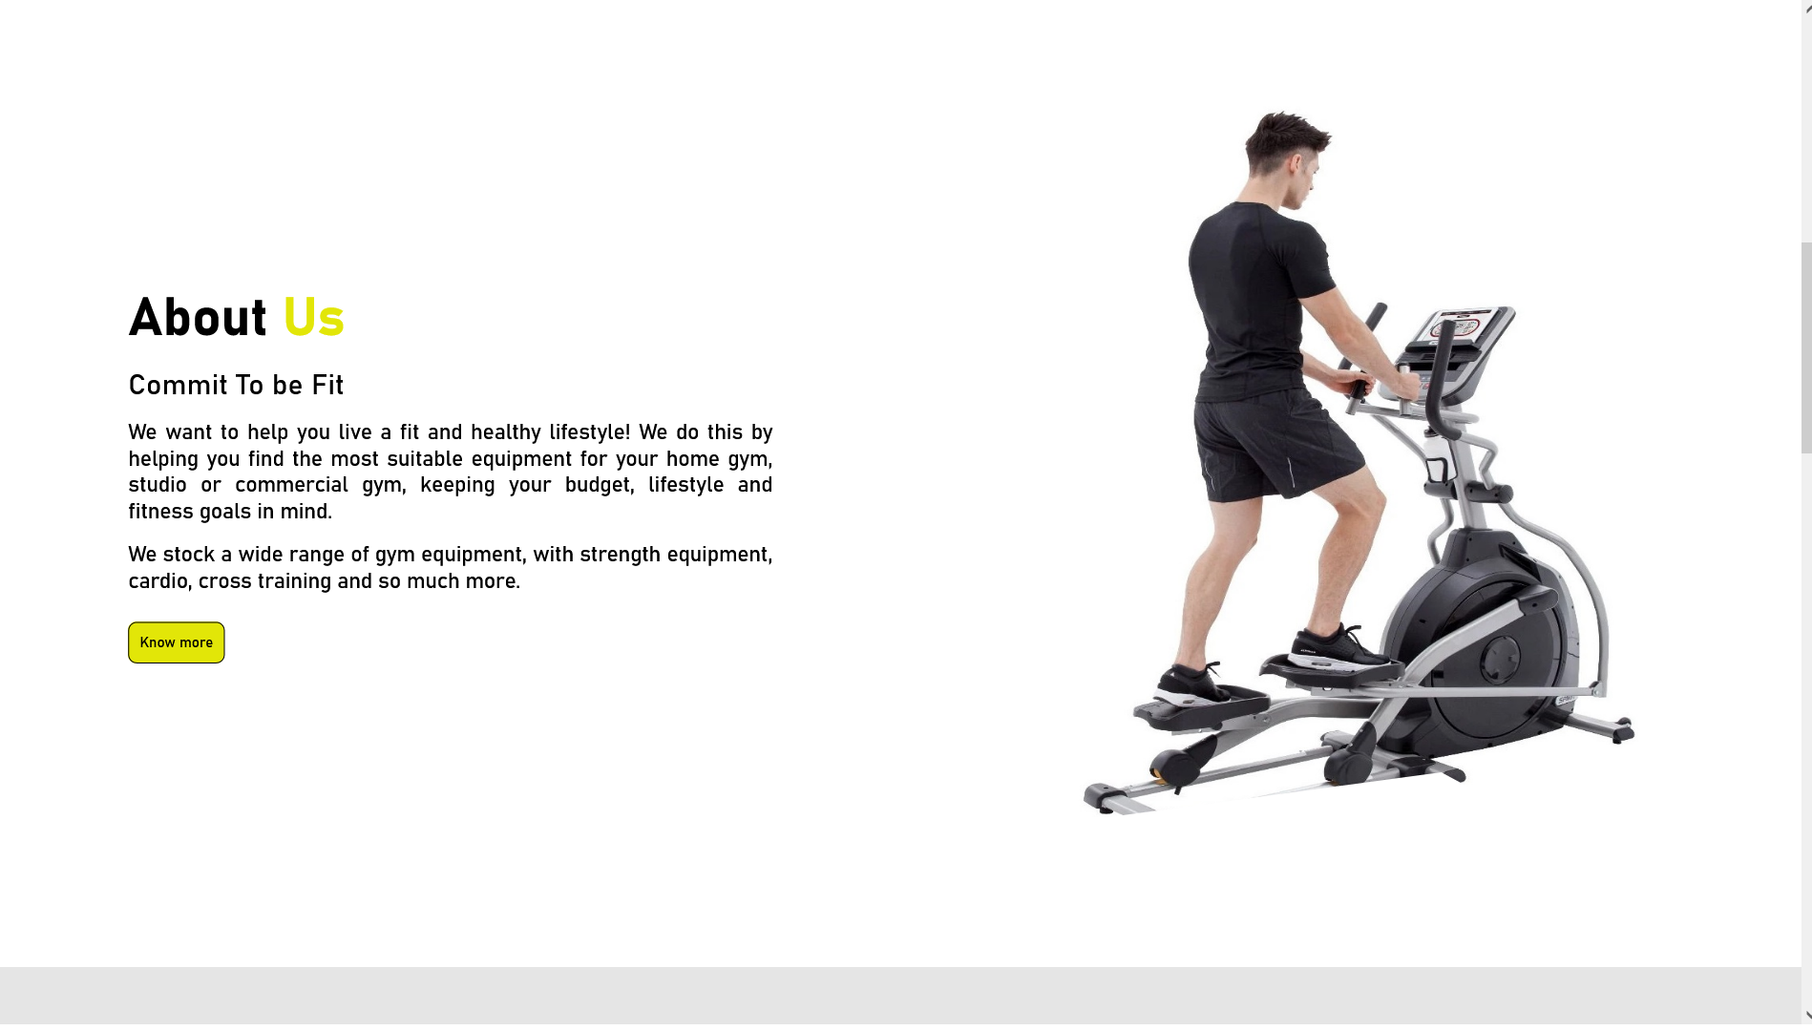
Experimental Setup & Variations

Slide 12
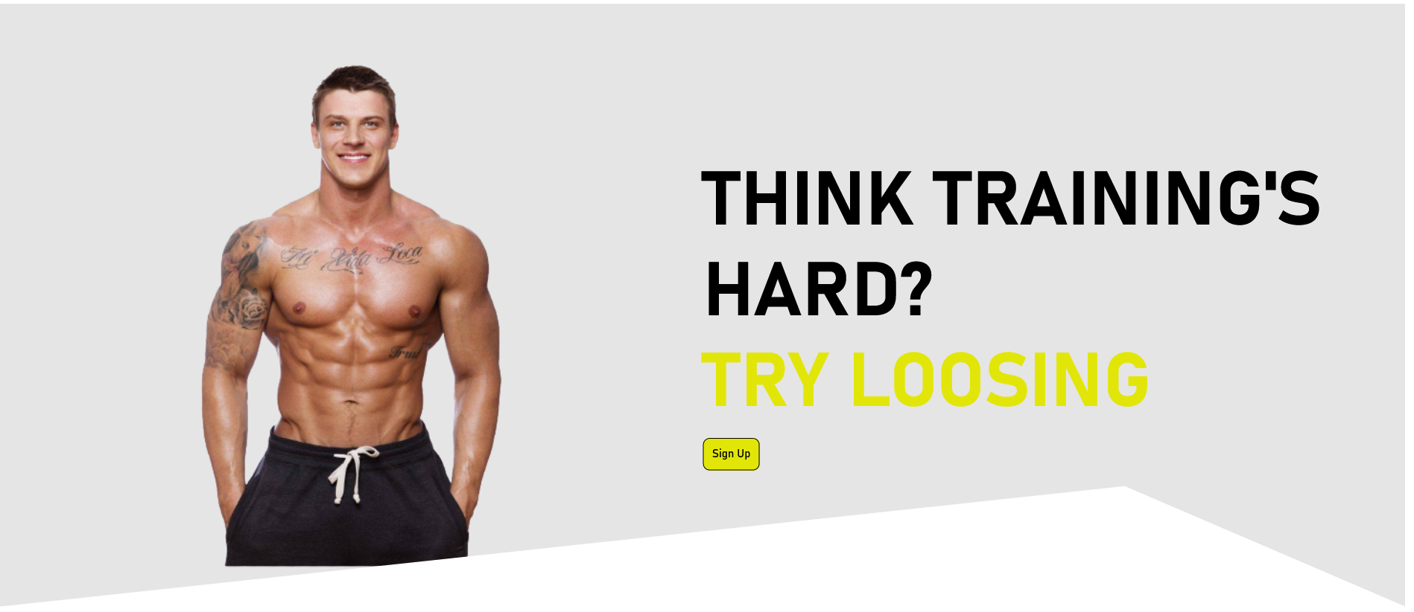

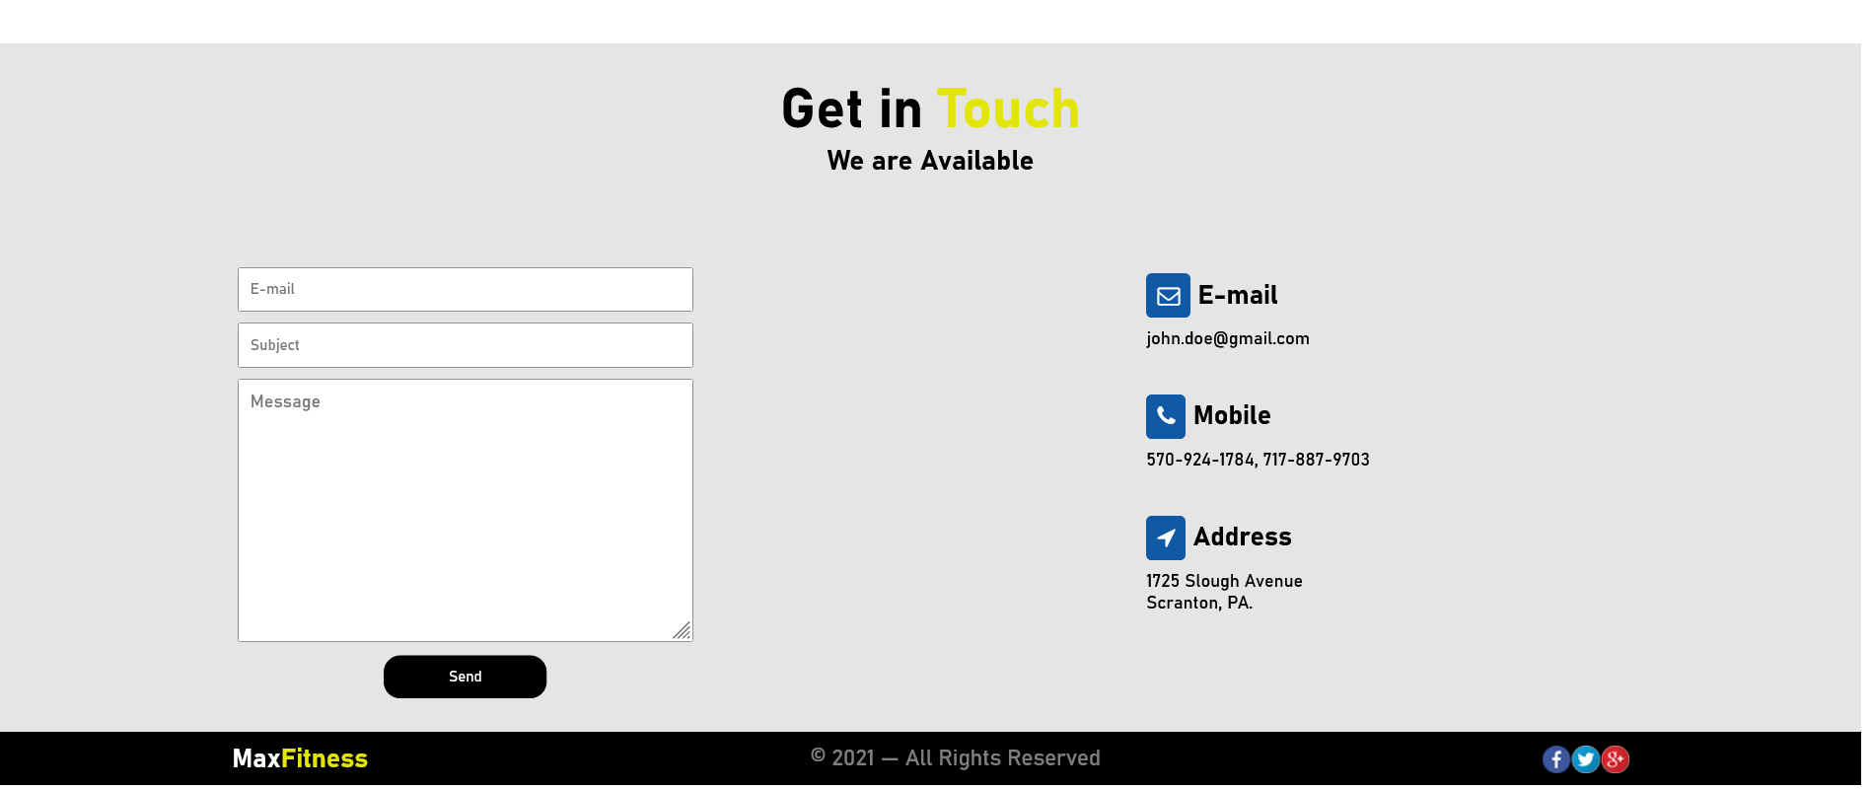

Slide 13
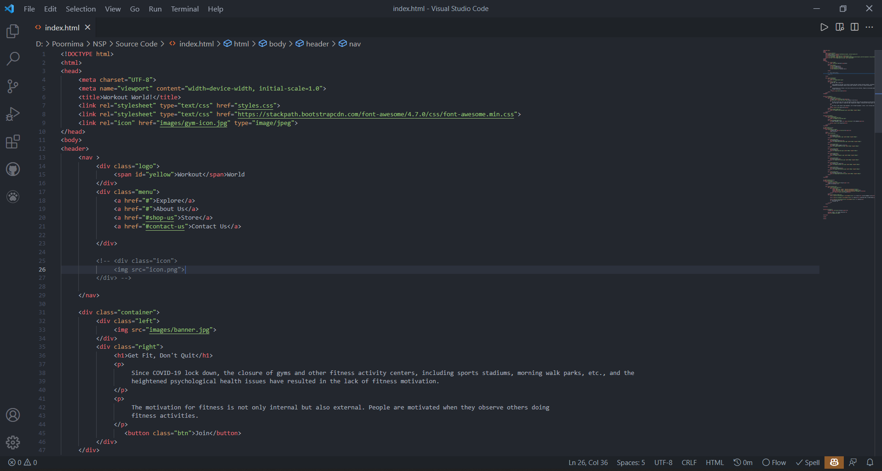
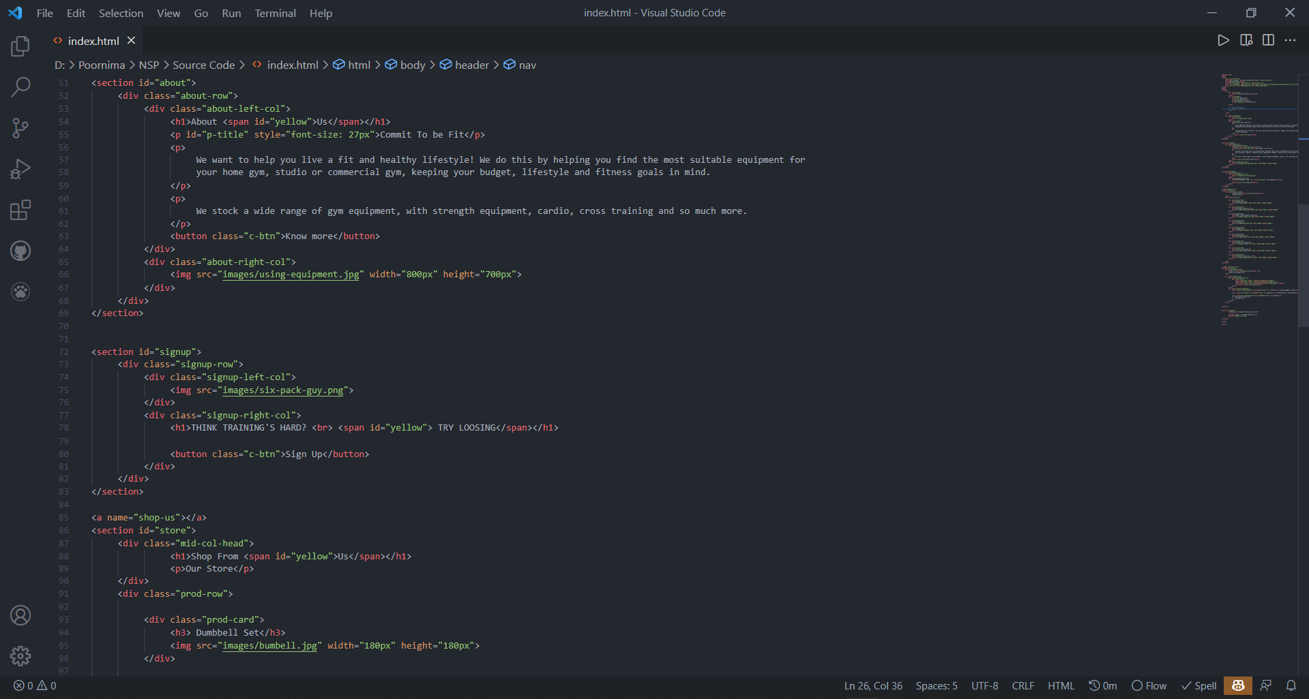
Designing of the Code

Slide 14
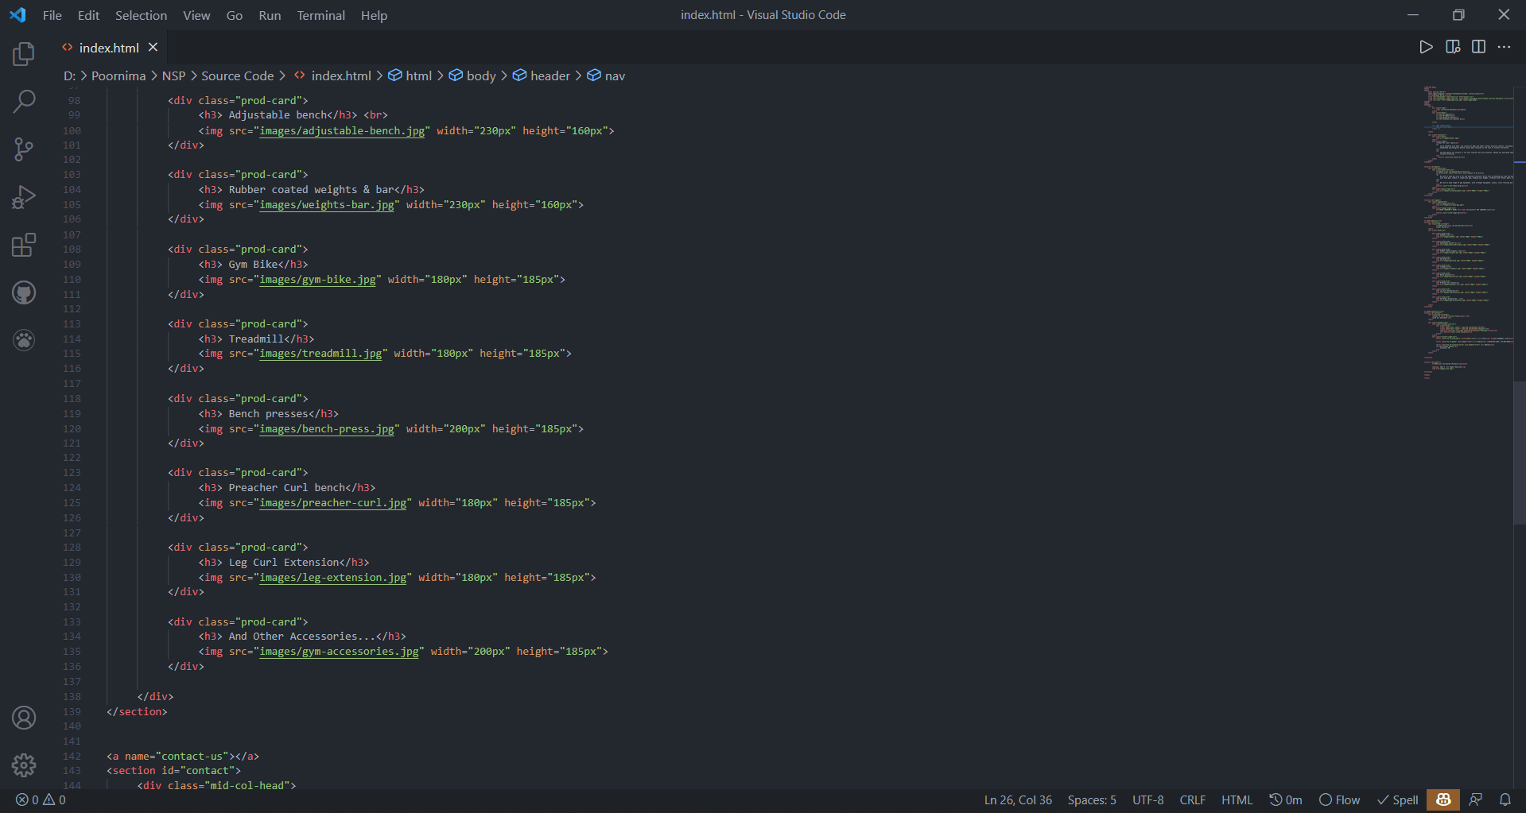
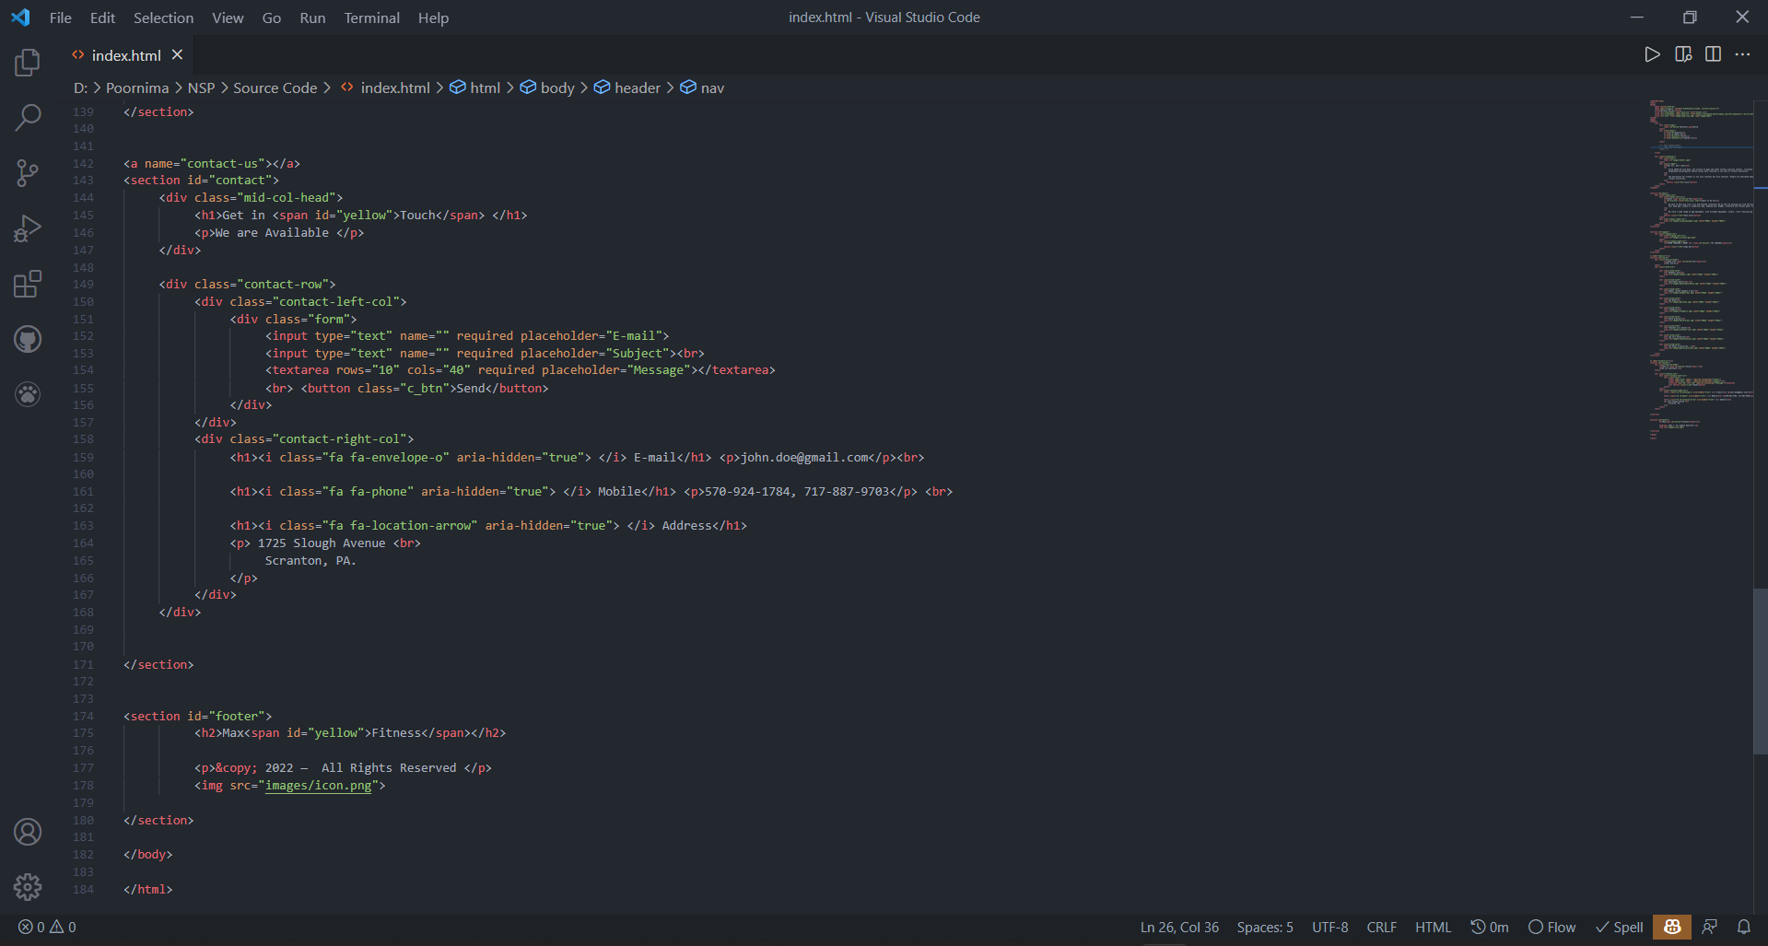

Slide 15
Results & Discussion
The project is in the mid way stage where almost all the frontend work is done, except for the part where new functionalities are to be added in future work.
The objective of this project was to build a program for maintaining the details of all the members, employees and inventory. The gym management system is properly performed to satisfy all the important requirements that we want in gym. The older system was tackled with so many problems/issues. The present project has been developed to make work easy and efficient. This system is automated system i.e. only use of machine work. Increased efficiency with reduced cost. Reduce the burden of paperwork. Better time management by recording the details of each and every member and employee.

Slide 16
Conclusion and Future Scope
The objective of our project is to develop and fulfill the user requirements such as recommending proper diet, exercise to user by well known expert and trainer, video or audio, chat, online payment, activity tracker will perform efficiently. So basically it satisfies all the requirements we want in the virtual gym. It should be flexible enough for future modifications. Every effort has been made to cover all user requirements and make it user friendly.
It may help collect perfect management intimately. during a very short time, the gathering are going to be obvious, simple and sensible. it'll help an individual to understand the management of past year perfectly and vividly. It also helps in current all works relative to Gym Website. it'll be also reduced the value of collecting the management & collection procedure will continue smoothly.

Slide 17
References
[1] Noora J. Ronkainen1, Arto J. Pesola, Olli Tikkanen and Ralf Brand, “Continuity and Discontinuity of Sport and Exercise Type During the COVID-19 Pandemic. An Exploratory Study of Effects on Mood”; Feb 2021
[2] Farzan Kamdin1, Kruti Khemani, Annamma Varghese, “COVID-19 lockdown impact on physical activity and anxiety levels among physiotherapy practitioners, teaching faculty and students in Mumbai”; April 2021
[3] Alejandro López-Valenciano, David Suárez-Iglesias, Miguel A. Sanchez-Lastra and Carlos Ayán, “Impact of COVID-19 Pandemic on University Students’ Physical Activity Levels: An Early Systematic Review (2021)
[4] Rohmad Apriyanto, Adi S, “Effectiveness Of Online Learning and Physical Activities Study in Physical Education During Pandemic Covid-19” (2021)
[5] Rebecca Hasson, James F. Sallis, Nailah Coleman, Navin Kaushal, Vincenzo G. Nocera, and NiCole Keith, “COVID-19: Implications for Physical Activity, Health Disparities, and Health Equity” (2021)

Slide 18
[5] Rebecca Hasson, James F. Sallis, Nailah Coleman, Navin Kaushal, Vincenzo G. Nocera, and NiCole Keith, “COVID-19: Implications for Physical Activity, Health Disparities, and Health Equity” (2021)
[6] Harleen Kaur, Tushar Singh, Yogesh Kumar Arya and Shalini Mittal, “Physical Fitness and Exercise During the COVID-19 Pandemic: A Qualitative Enquiry” (2020)
[7] Astrid Roe1, Marte Blikstad-Balas and Cecilie Pedersen Dalland, “The Impact of COVID19 and Homeschooling on Students’ Engagement With Physical Activity”
[8] Laura J. Wright*, Sarah E. Williams and Jet J. C. S. Veldhuijzen van Zanten, “Physical Activity Protects Against the Negative Impact of Coronavirus Fear on Adolescent Mental Health and Well-Being During the COVID-19 Pandemic” (2021)
[9] Sunday O. Onagbiye1, Zandile June-Rose Mchiza, Ezihe L. Ahanonu, Susan H. Bassett and Andre Travill, “Mental Health and Physical Activity: A COVID-19 Viewpoint” (2021)
[10] Jeffrey A. Woods, Noah T. Hutchinson, Scott K. Powers, William O. Roberts, “The COVID-19 pandemic and physical activity (2020)

Slide 19

Thanks & QA

